Slide 1
Tensorflow- Workshop
Raghav
Phd Student
University of Syndey

Slide 2
Agenda
Tensorflow- Introduction
Install
Concepts
Tensorflow- Alternatives- Comparison Study
High Level Libraries: Tensorflow
MNIST- Example
Tensorboard- Basics
How to code your own loss function ?

Slide 3
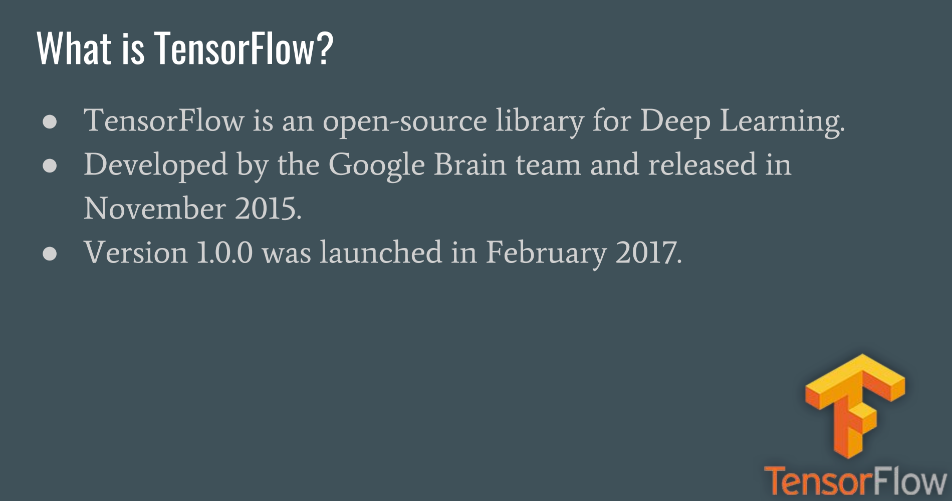

Slide 4
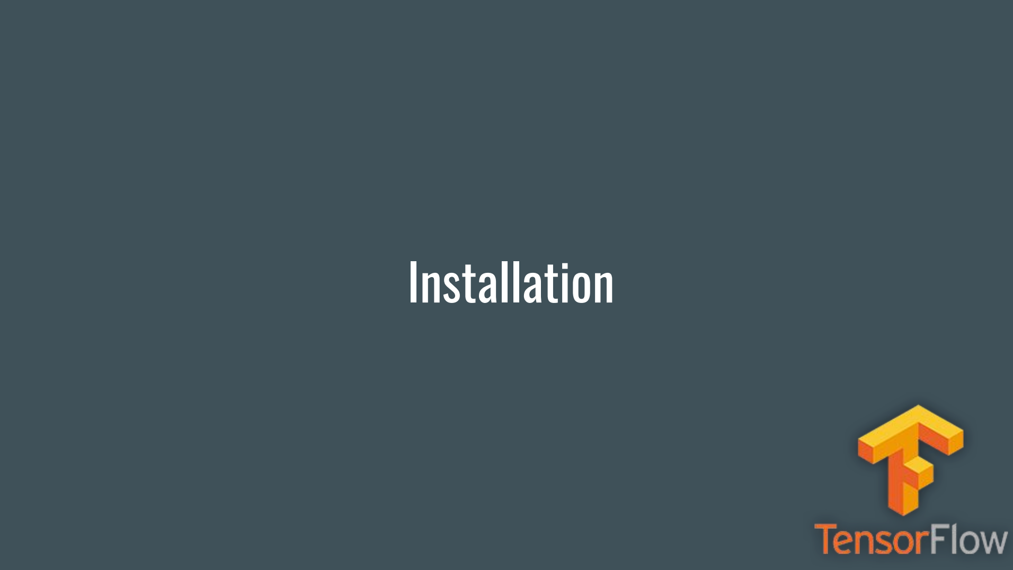

Slide 5
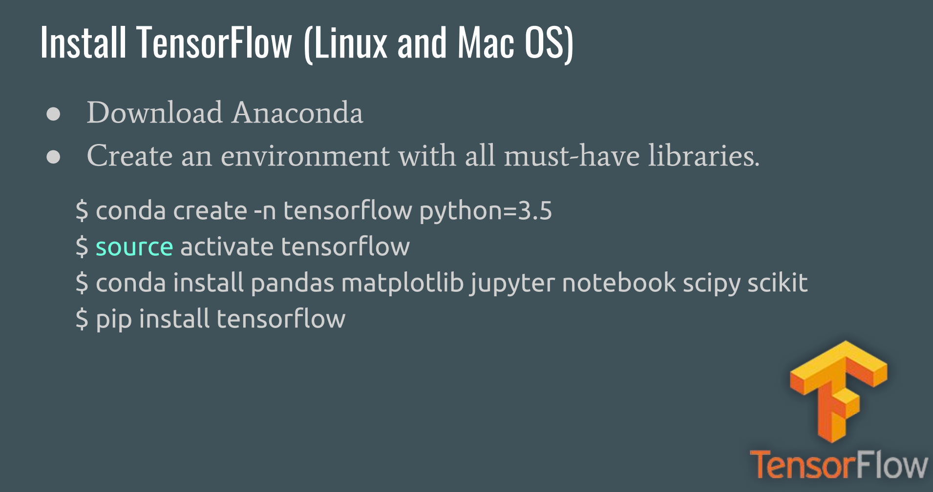

Slide 6
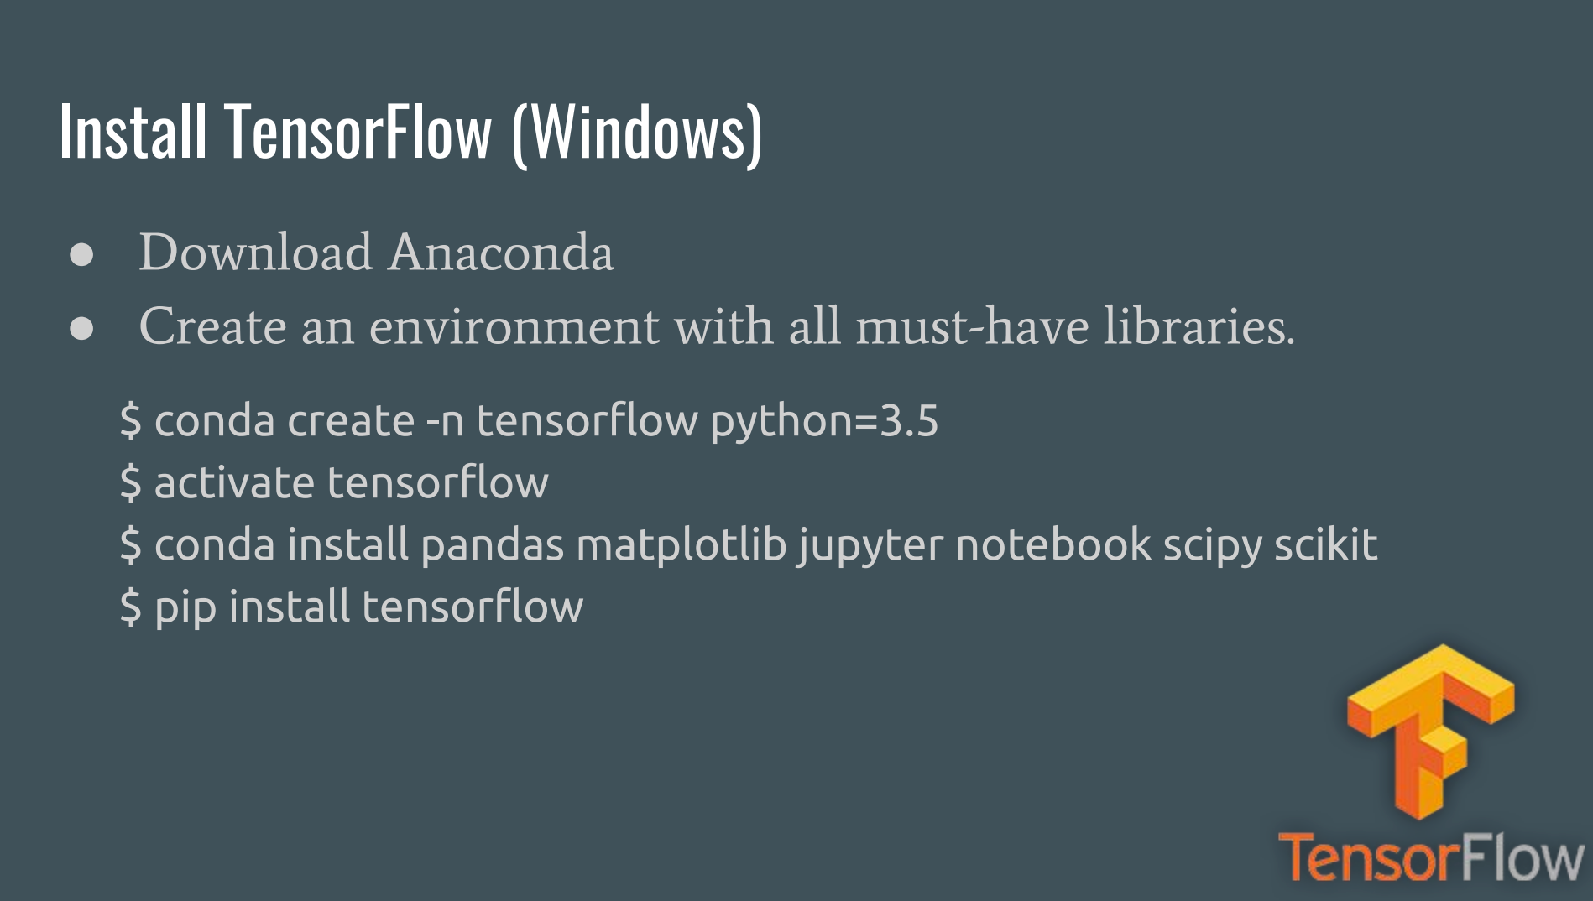

Slide 7
CONCEPTS

Slide 8
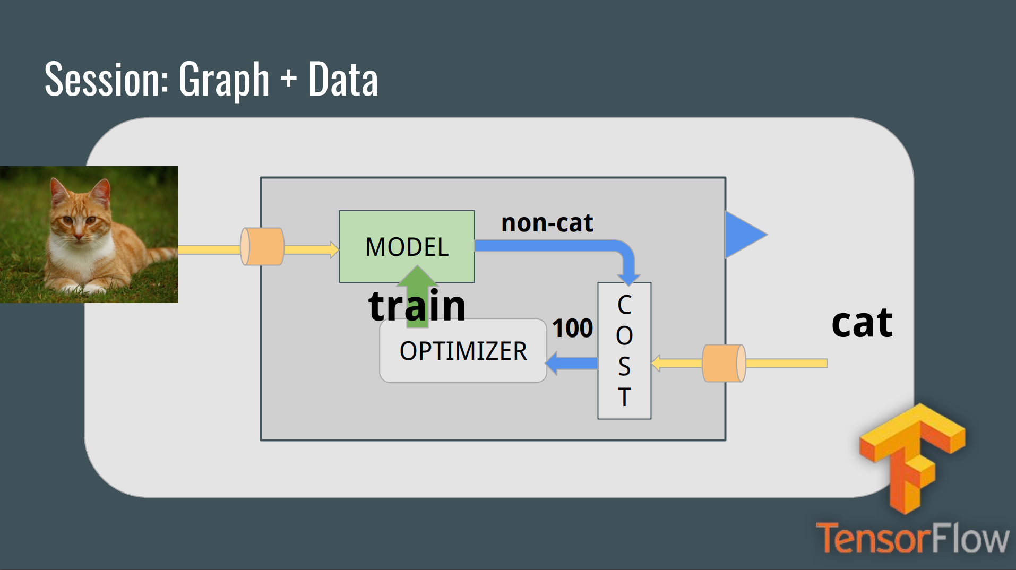

Slide 9
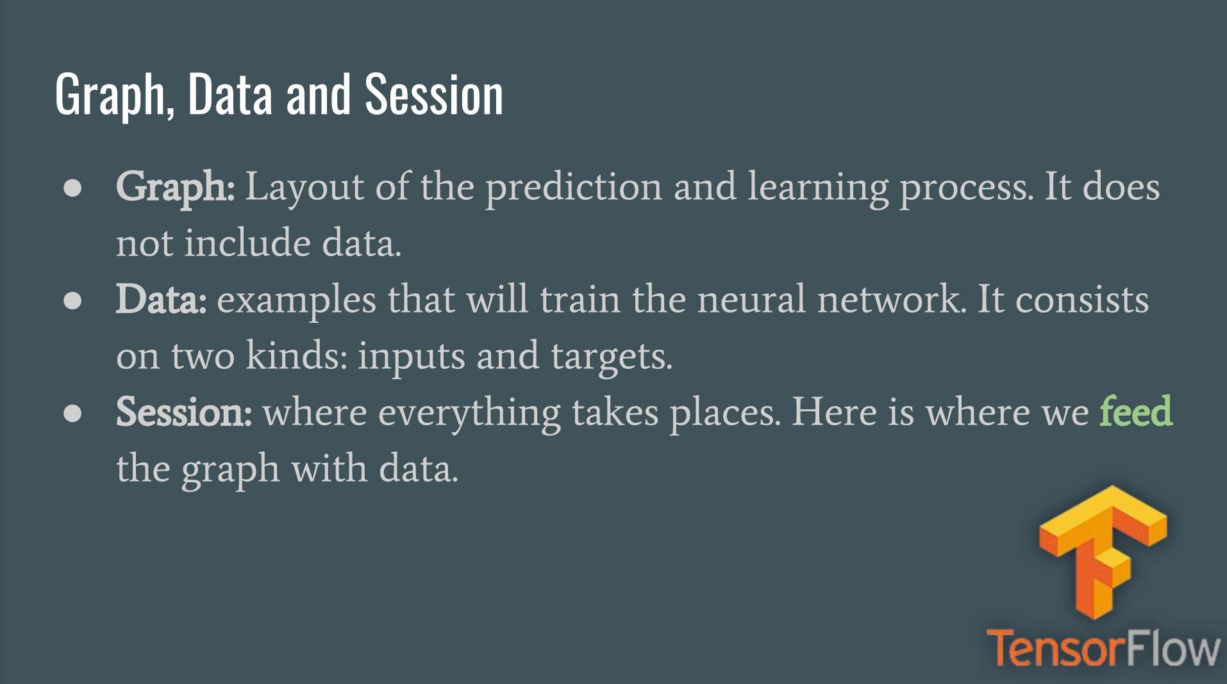

Slide 10
TensorFlow: Alternatives

Slide 11
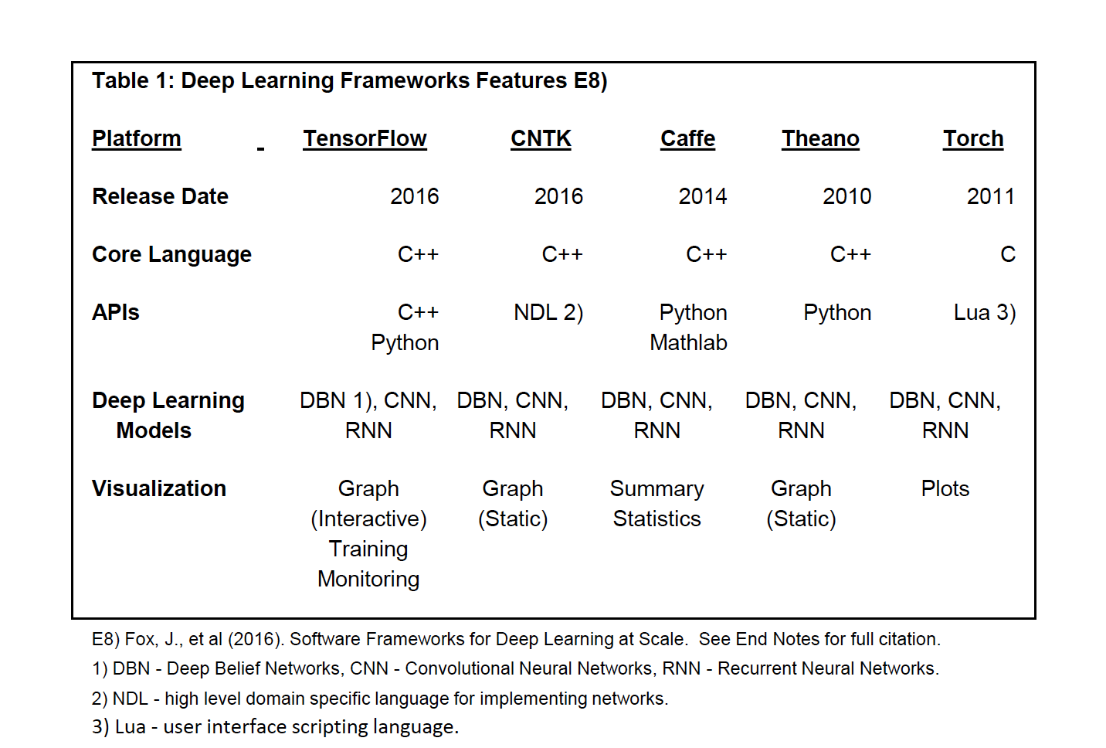
Deep Learning Frameworks

Slide 12
Api’s- Save a lot of Time while Prototyping

Slide 13
MNIST- MultiClass Classifier Using a) Tensorflow B) Keras C) TFLEARn

Slide 14
MNIST- Digit Recognizer

Slide 15
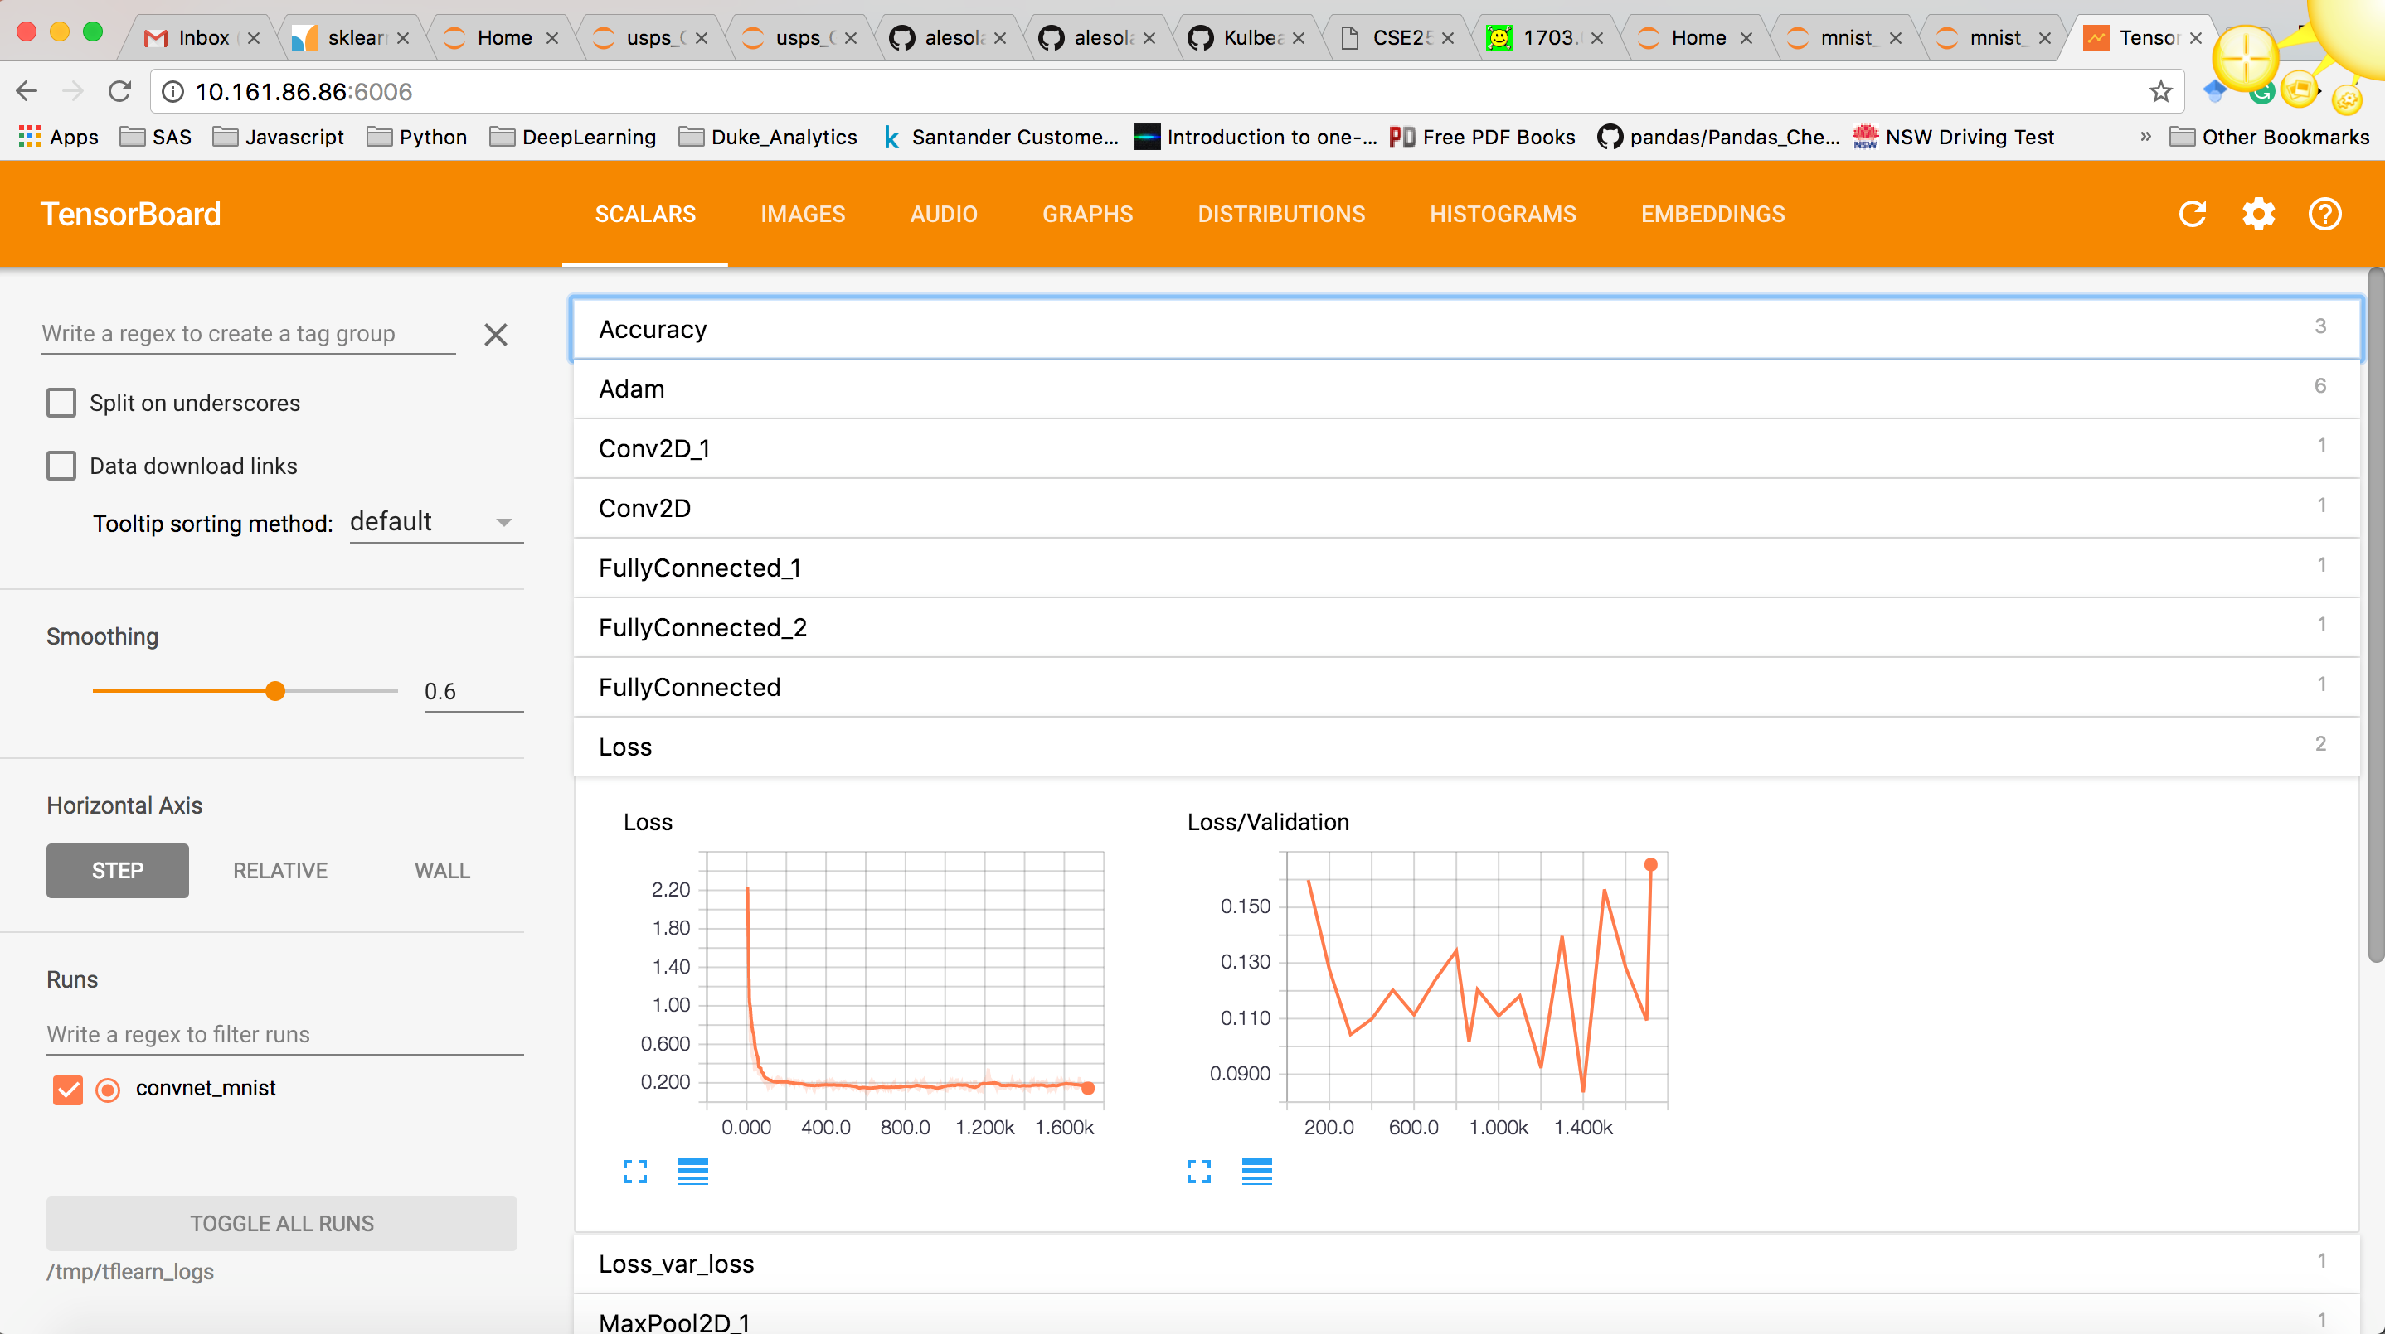
Tensorboard : Basics

Slide 16
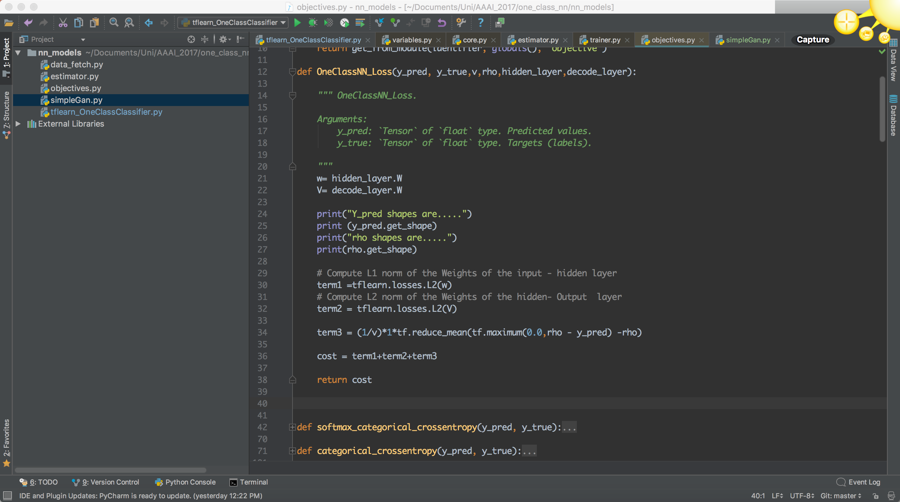
How to Customize Loss Function

